Slide 1


Case Study Report: Enhancing Runway and Taxiway Management Systems with Sensor Technology and Real-Time Data Processing
Airports globally face increasing challenges in managing runway and taxiway operations due to growing air traffic, heightened safety requirements, and the need for operational efficiency. This case study addresses how innovations in sensor technology and real-time data processing can be applied to develop a smart runway and taxiway management system, focusing on enhancing safety, improving traffic flow, and maximizing operational efficiency at busy airports.

Slide 2

Introduction
Airports globally face increasing challenges in managing runway and taxiway operations due to growing air traffic, heightened safety requirements, and the need for operational efficiency. This case study addresses how innovations in sensor technology and real-time data processing can be applied to develop a smart runway and taxiway management system, focusing on enhancing safety, improving traffic flow, and maximizing operational efficiency at busy airports.

Slide 3
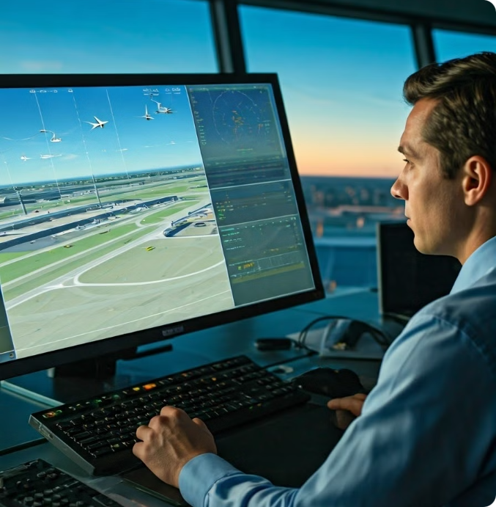
Problem Statement
The primary objective is to develop a smart runway and taxiway management system that can efficiently monitor, manage, and optimize aircraft and ground vehicle movements. This system must use advanced sensor technology and real-time data processing to provide accurate, timely information to air traffic controllers and ground personnel, thereby improving safety, reducing delays, and increasing airport throughput.

Slide 4
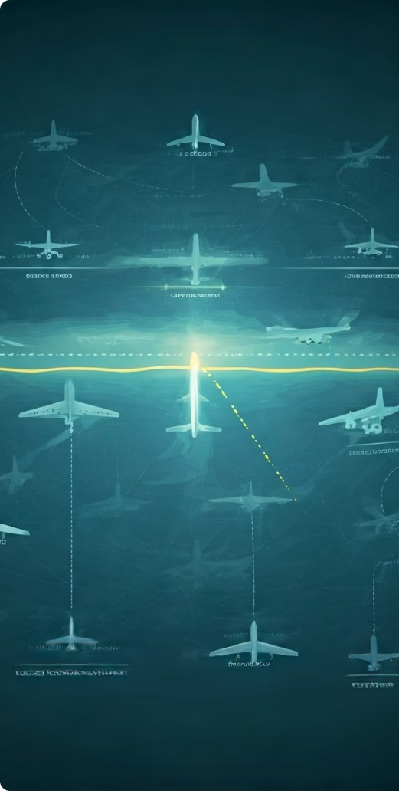
Analysis of Current Challenges
Safety Concerns
Traffic Flow Management
Operational Efficiency
Runway incursions, where unauthorized vehicles or aircraft enter active runways, pose significant safety risks. - Existing systems may lack the precision and real-time capability needed to detect and prevent such incidents.
The increase in air traffic leads to congestion on runways and taxiways, causing delays. Traditional management systems may not efficiently optimize the flow of aircraft, leading to inefficiencies.
Airports must maximize runway and taxiway utilization to handle increasing traffic without compromising safety. Delays in aircraft taxiing and takeoff/landing operations reduce overall airport efficiency and throughput.

Slide 5

Innovative Approach: AI-Powered Sensor Integration for Predictive Analytics
Sensor Technology Integration
AI and Real-Time Data Processing
Smart System Integration and Communication
LIDAR and Radar Sensors
Predictive Analytics using AI
Autonomous Ground Vehicle Coordination
IoT-Enabled Sensors
Edge Computing for Real-Time Processing
Real-Time Communication with Aircraft

Slide 6

Innovative Approach: AI-Powered Sensor Integration for Predictive Analytics
The proposed solution combines advanced sensor technologies with AI-driven predictive analytics to create a smart runway and taxiway management system.

Slide 7
A. Sensor Technology Integration
LIDAR and Radar Sensors
IoT-Enabled Sensors
LIDAR Sensors: These sensors provide high-resolution 3D mapping of the airport surface, detecting aircraft and ground vehicles with precision. LIDAR's ability to work in various lighting and weather conditions makes it ideal for continuous monitoring.
Environmental Sensors: IoT devices monitor environmental factors such as visibility, temperature, and wind speed, providing critical data that influences runway and taxiway operations.
Ground Sensors: Embedded sensors on runways and taxiways detect the presence of aircraft and ground vehicles, offering real-time data on their exact locations.
Radar Sensors: Complementing LIDAR, radar sensors offer long-range detection capabilities, enabling the system to monitor moving objects across larger areas of the airport, even in poor weather conditions.

Slide 8

B. AI and Real-Time Data Processing
1
Predictive Analytics using AI
2
Predictive Models
Machine learning models analyze historical and real-time data to predict potential bottlenecks, runway incursions, or safety risks. For instance, AI can predict the likelihood of a runway incursion based on the movement patterns of aircraft and ground vehicles.
Data Fusion: AI algorithms integrate data from LIDAR, radar, and IoT sensors to create a comprehensive, real-time view of runway and taxiway operations.
3
Optimization Algorithms
4
Edge Computing for Real-Time Processing
AI-driven optimization algorithms dynamically allocate runway and taxiway resources, suggesting the most efficient taxi routes and takeoff/landing sequences. This reduces delays and enhances traffic flow.
Local Processing: Edge computing devices located near critical points on runways and taxiways process sensor data locally, ensuring low-latency responses. This is crucial for making split-second decisions in dynamic environments like airports.

Slide 9





C. Smart System Integration and Communication
Autonomous Ground Vehicle Coordination
Human-Machine Interface
Real-Time Communication with Aircraft
Collaborative Decision Making
AI-Driven Coordination: The system can control autonomous ground vehicles (e.g., tugs, baggage carts) to ensure they do not interfere with aircraft movements. These vehicles receive real-time data from the system to navigate efficiently and safely.
A user-friendly interface ensures that air traffic controllers and ground personnel can easily interact with the system, receiving timely alerts and recommendations.
Pilot Interface: The system provides pilots with real-time information on optimal taxi routes, expected delays, and safety advisories directly to their cockpit displays.
The AI system works collaboratively with human operators, offering suggestions while allowing for human intervention in critical situations.

Slide 10
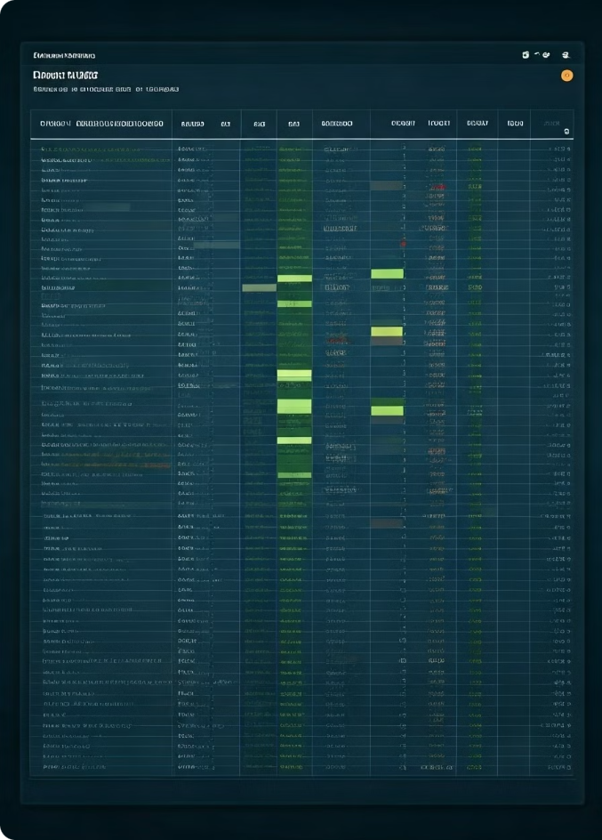
Feasibility of the Approach
Technological Feasibility
Maturity of Sensor Technology
AI and Data Processing Capabilities
Cost-Effectiveness
Initial Investment
Operational Savings
Scalability and Adaptability
Scalable Deployment
Adaptation to Airport Size
Potential Challenges
Cybersecurity Risks
Stakeholder Acceptance

Slide 11

AI-Powered Runway and Taxiway Management Systems
The integration of AI-powered sensor technology and real-time data processing represents the best innovative approach to enhancing runway and taxiway management systems at busy airports. This approach is not only technologically feasible but also offers significant long-term benefits in terms of safety, efficiency, and cost-effectiveness. By addressing current challenges and leveraging mature technologies, the proposed system has the potential to revolutionize airport ground operations, paving the way for safer, more efficient air travel.

Slide 12

A. Technical Feasibility
Technological Feasibility
AI and Data Processing Capabilities
Edge and
Cloud Computing
Maturity of Sensor Technology: LIDAR and radar technologies are well-established and have been successfully implemented in various industries, including autonomous vehicles and industrial automation. IoT devices are widely available and can be easily integrated with existing airport infrastructure. The technology's modular nature allows for phased implementation, reducing initial complexity.
The current state of edge and cloud computing technologies supports the real-time processing and large-scale data analysis required for this system. These technologies are also scalable, allowing the system to evolve with increasing airport demands.
AI Maturity: AI algorithms, particularly in predictive analytics and optimization, have reached a level of maturity that makes their deployment in critical systems feasible. Numerous AI-powered applications in transportation, healthcare, and finance demonstrate the robustness of these technologies.

Slide 13
B. Cost-Effectiveness
Initial Investment
Sensor Installation
While the initial cost of installing LIDAR, radar, and IoT sensors may be high, the long-term benefits in terms of improved safety, reduced delays, and optimized operations justify the investment.
Operational Savings
Reduced Delays
By optimizing traffic flow and reducing runway incursions, the system significantly decreases delays, translating into cost savings for airlines and the airport.
Enhanced Safety
Fewer safety incidents lead to lower insurance costs and reduced liability risks for airport operators.

Slide 14
C. Scalability and Adaptability
Scalable Deployment
Regulatory Compliance
Modular Design: The system can be implemented in stages, starting with critical runways or taxiways, and gradually expanding to cover the entire airport. This allows airports to spread out the costs and manage risks more effectively.
Aviation Standards: The system's development aligns with existing aviation safety regulations and standards. By enhancing safety, it supports regulatory objectives, making it easier to gain approval from aviation authorities.
Adaptation to Airport Size: The system can be customized to fit airports of various sizes, from regional hubs to major international gateways.

Slide 15




D. Potential Challenges
Cybersecurity Risks
Data Protection: Implementing robust cybersecurity measures is essential to protect the integrity of the sensor data and AI algorithms, preventing unauthorized access and potential system sabotage.
AI Reliability
Ensuring that AI-driven decisions are accurate and reliable requires extensive testing and validation, particularly in a safety-critical environment like an airport.
Stakeholder Acceptance
Training and Adaptation: Air traffic controllers, pilots, and ground personnel will need training to effectively use the new system. Building trust in AI recommendations is crucial for successful adoption.

Slide 16

Conclusion: Revolutionizing Airport Ground Operations
1
Enhanced Safety
2
Increased Efficiency
AI-powered systems can detect potential hazards and issue real-time alerts to ground personnel, minimizing the risk of accidents and incidents.
Real-time data analysis enables optimization of aircraft movements, reducing delays and maximizing overall airport throughput.
3
Cost-Effectiveness
4
Future-Proofing
By automating tasks and improving operational efficiency, AI-powered systems can deliver significant cost savings for airports.
The integration of AI and sensor technology offers a scalable and adaptable solution, ensuring the system evolves alongside future advancements in aviation technology.

